Slide 1
Employee Performance Analysis Using Excel
PRESENTED BY: Varsha R
REGISTER NO: 312204641
DEPARTMENT: COMMERCE
COLLEGE: K C S KASI NADAR COLLEGE OF ARTS AND SCIENCE

Slide 2
PROJECT TITLE
Employee Performance Analysis Using Excel

Slide 3
AGENDA
1.Problem Statement
2. Project Overview
3.End Users
4.Our Solution and Proposition
5. Dataset Description
6. Modelling Approach
7. Results and Discussion
8.Conclusion

Slide 4
PROBLEM STATEMENT
To evaluate and rectify any discrepancies or issues within the pivot table that summarizes employee IDs based on performance categories.
Discrepancy in Data Distribution:
Issue: The "Fully Meets" and "Needs Improvement" categories each have a sum total of employee IDs, but there is no entry for some employees in the "Needs Improvement" category where it might be expected.
Objective: Investigate whether any employee IDs that should belong to the "Needs Improvement" category are missing, and ensure all relevant employees are categorized correctly.
Validation of Grand Total:
Issue: The grand total of 34,815, which is the sum of all employee IDs across categories, should match the total calculated from the individual categories ("Fully Meets" and "Needs Improvement") and any blank entries.
Objective: Confirm that the grand total accurately reflects the sum of all categorized and non-categorized employee IDs and investigate any potential misalignment or errors.

Slide 5
PROJECT OVERVIEW
[Employee Performance Improvement and Pay Zone Optimization]
Using Pivot Tables for Employee Turnover Analysis
Visualizing Employee Attendance Trends with Excel Charts
Salary and Compensation Analysis Through Excel Data Modeling
Data Manipulation Techniques, Conditional Formatting, Pivot Table, Functions and Formulas, Power Query, Charts and Graphs

Slide 6
WHO ARE THE END USERS?
Department Managers (Sales & Production)
Senior Leadership/Executives
Employees

Slide 7
OUR SOLUTION AND ITS VALUE PROPOSITION
Filtering - Remove missing values.
Conditional Formatting - Blanks, Background Color Shading, Data Bars, Values.
Data Filtering and Sorting - Identify specific employee groups, such as those with exceeds, needs improvements and fully meets.
Pivot table - Summary of employee performance under their current rating .
Graphs - Final Report.

Slide 8
DATASET DESCRIPTION
EMPLOYEE ID: Unique identifier for each employee in the organization.
FIRST NAME: The first name of the employee.
PERFORMANCE SCORE: A score indicating the employee's performance level (e.g., Excellent, Satisfactory, Needs Improvement).

Slide 9
MODELLING
Data set: Kaggle, Employee dataset
Feature Selection: Slicer, Conditional Formatting, Designing.
Data Cleaning: Missing values, Irrelevant data, correct errors.
Pivot Table: Employee ID, First Name, Performance score.
Chart: fully meets, Needs improvement.

Slide 10
RESULTS

Slide 11
CONCLUSION
The project focuses on improving employee performance and aligning compensation through data analysis and strategic interventions. Using Excel as a primary tool provides an accessible, cost-effective, and flexible solution for analyzing employee performance, Pay Zones, and departmental efficiency.
By identifying performance gaps, creating targeted improvement plans, and adjusting compensation strategies, the company can:
Boost overall productivity.
Increase employee satisfaction and retention.-
Ensure fair and equitable compensation across Pay Zones.
Excel's powerful data analysis, visualization, and scenario planning capabilities enable real-time tracking, informed decision-making, and clear communication of insights to stakeholders. This solution offers a comprehensive approach to enhancing workforce performance and aligning it with organizational goals.

Slide 12
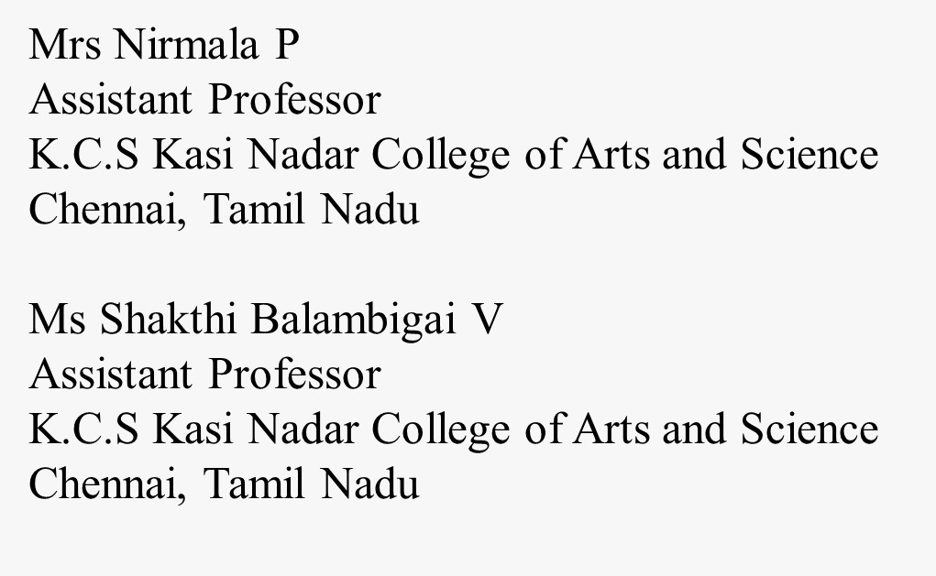
REFERENCE

